Slide 1

Commonality and Solidarity in the Government Shutdown of 2018-2019
Labor Union Cooperation during the Longest Shutdown in the History of the United States

Slide 2

'
|
Chicago Tribune – Nov. 28, 2016
https://www.chicagotribune.com/nation-world/ct-drain-the-swamp-donald-trump-20161128-story.html
Drain the swamp'? Federal workers worried about Trump plan

Slide 3
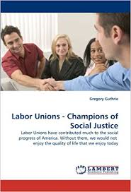
Georgetown thesis published as a book.

Slide 4
Uphold the Oath
I, [name], do solemnly swear (or affirm) that I will support and defend the Constitution of the United States against all enemies, foreign and domestic; that I will bear true faith and allegiance to the same; that I take this obligation freely, without any mental reservation or purpose of evasion; and that I will well and faithfully discharge the duties of the office on which I am about to enter. So help me God.”
Oath for Federal Employees

Slide 5
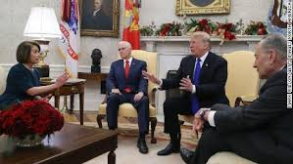
Dec 11, 2018
President Trump, House Minority Leader Nancy Pelosi (D-CA) and Senate Minority Leader Chuck Schumer (D-NY) have a heated debate in the Oval Office about border security and funding the government. (source: CNN)

Slide 6
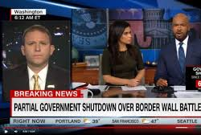

Randy Erwin –President , National Federation of Federal Employees (NFFE)

Slide 7
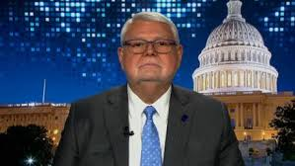

J. David Cox – President American Federation of Government Employees (AFGE)

Slide 8
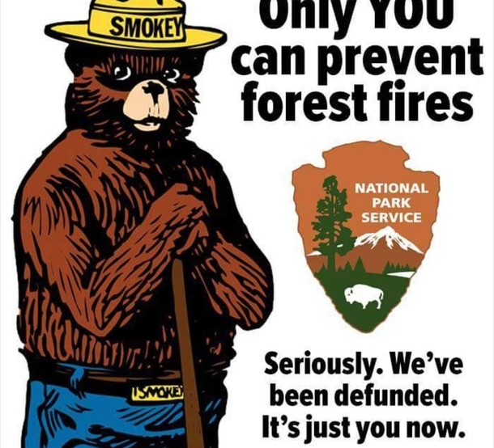
Rally at AFL-CIO 1/10/2019
The Forest Service Council is a major component of the National Federation of Federal Employees (NFFE)

Slide 9
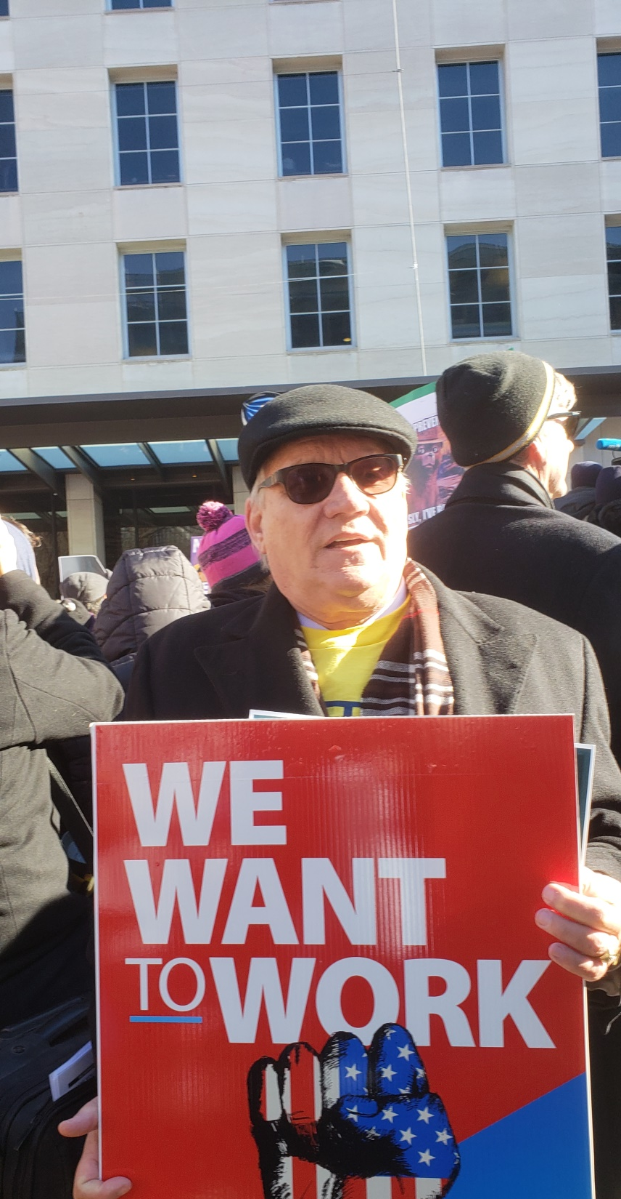
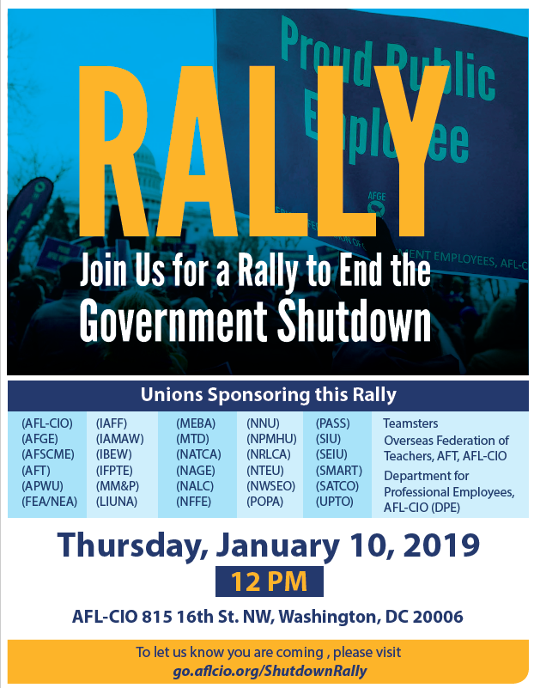
Rally at AFL-CIO 1/10/2019

Slide 10
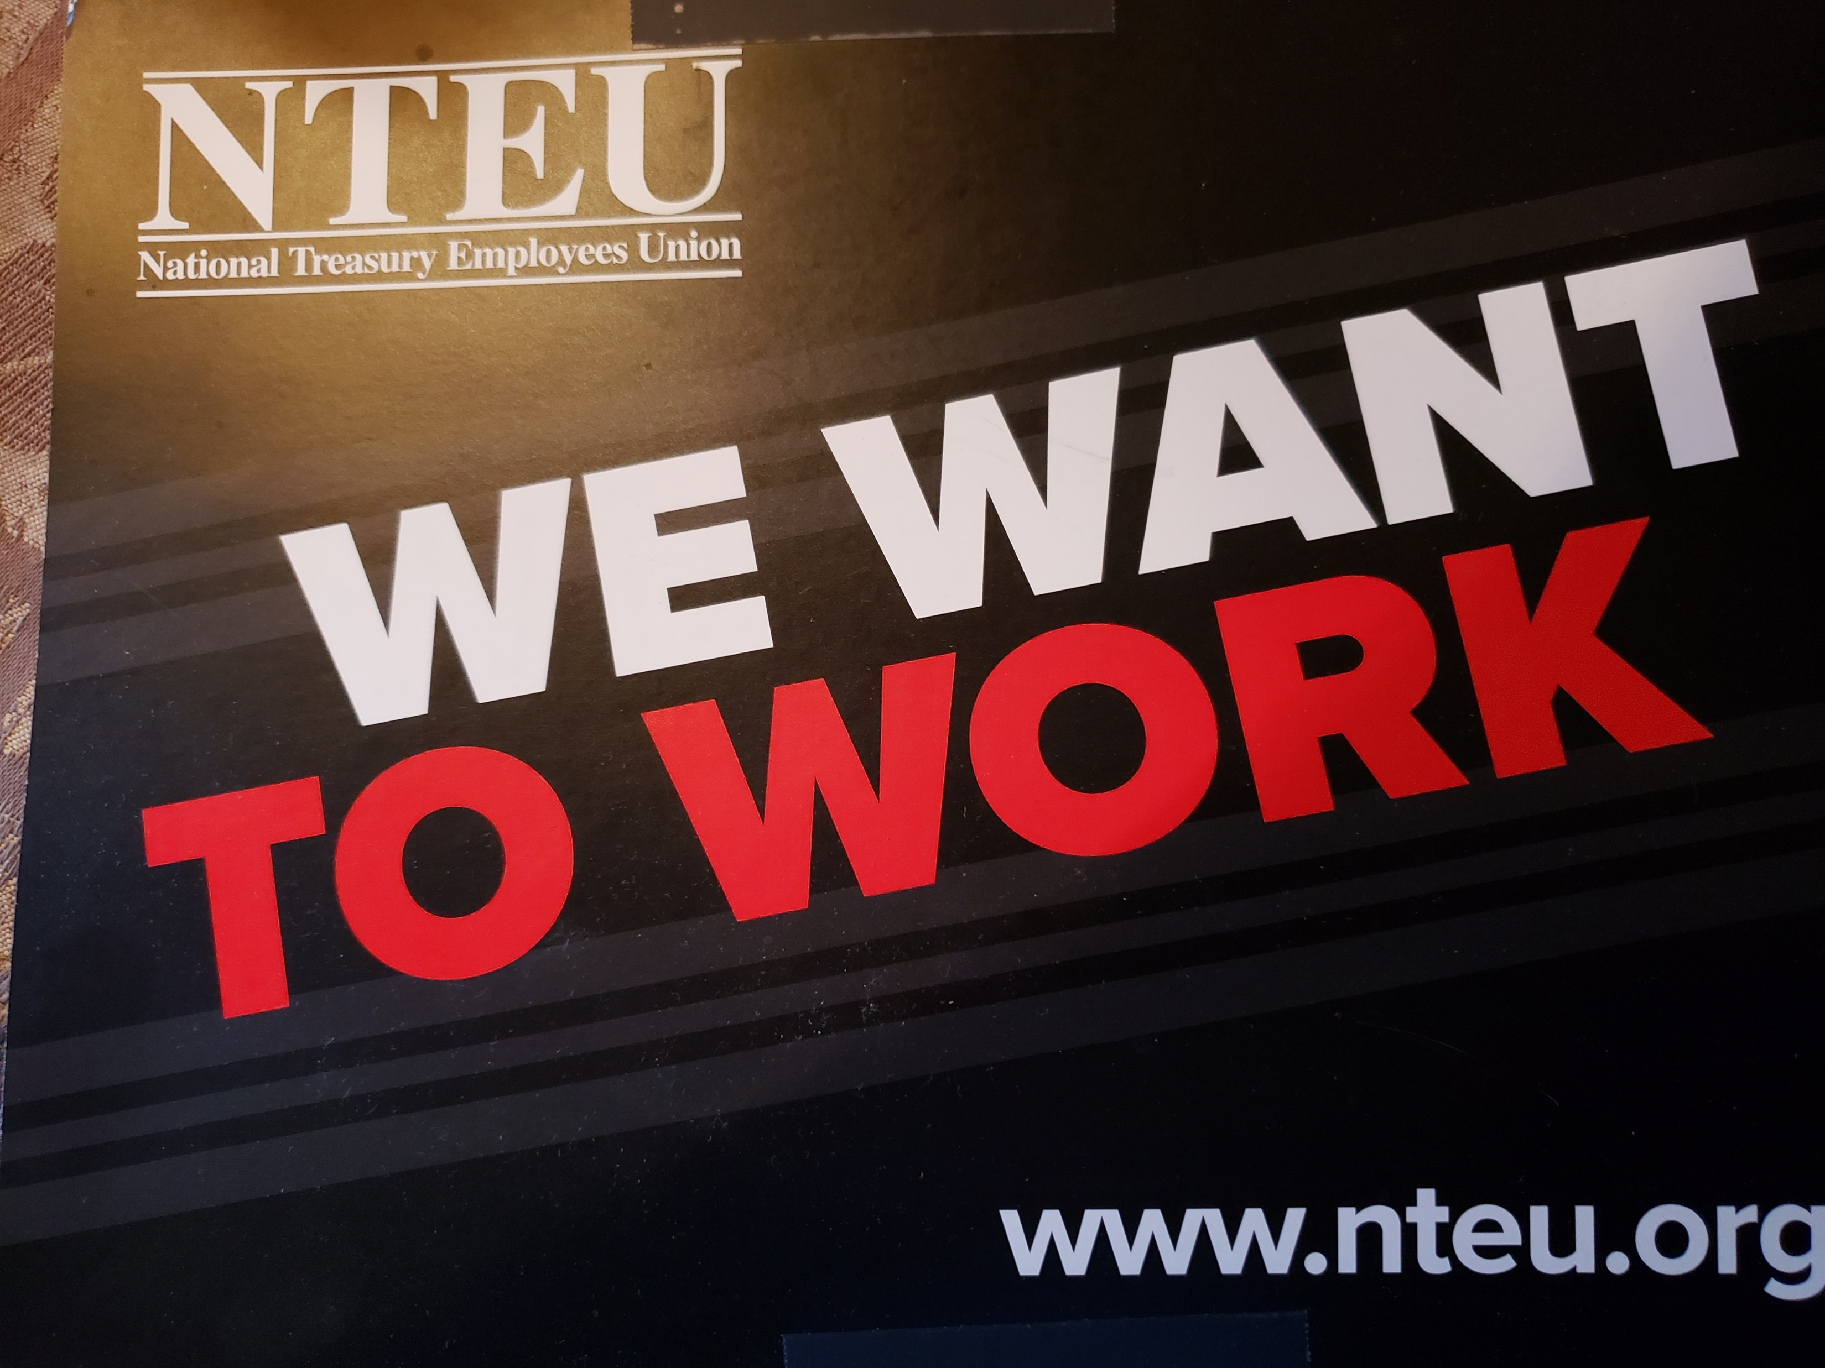

Slide 11
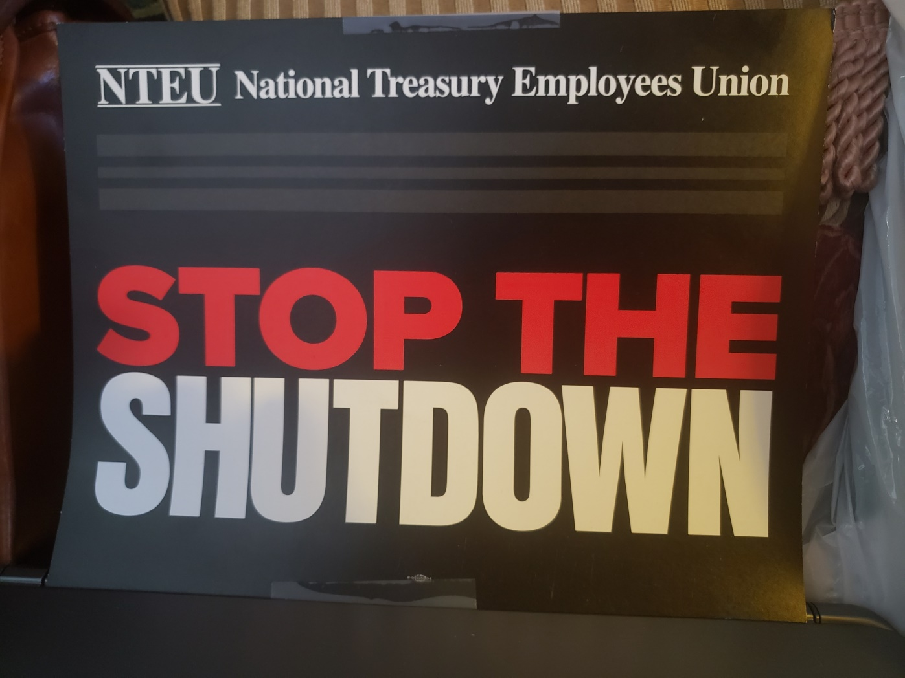
..

Slide 12
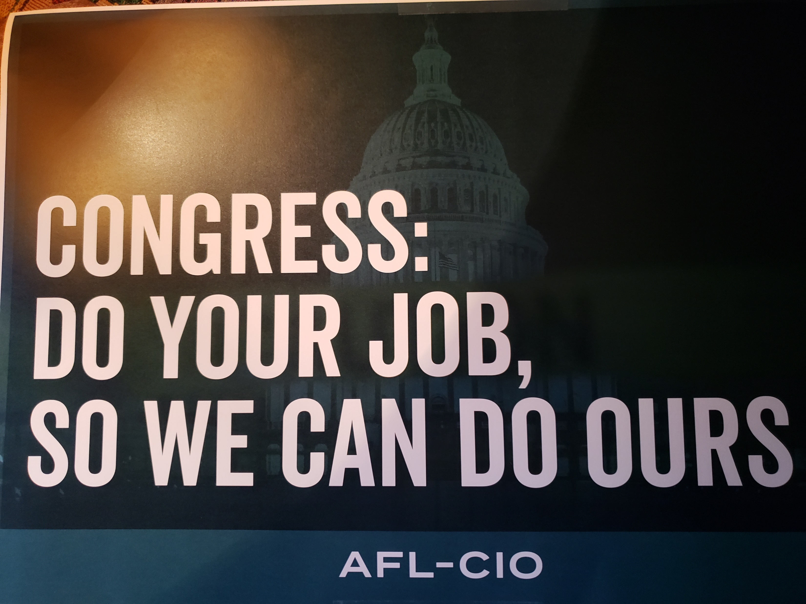

Slide 13
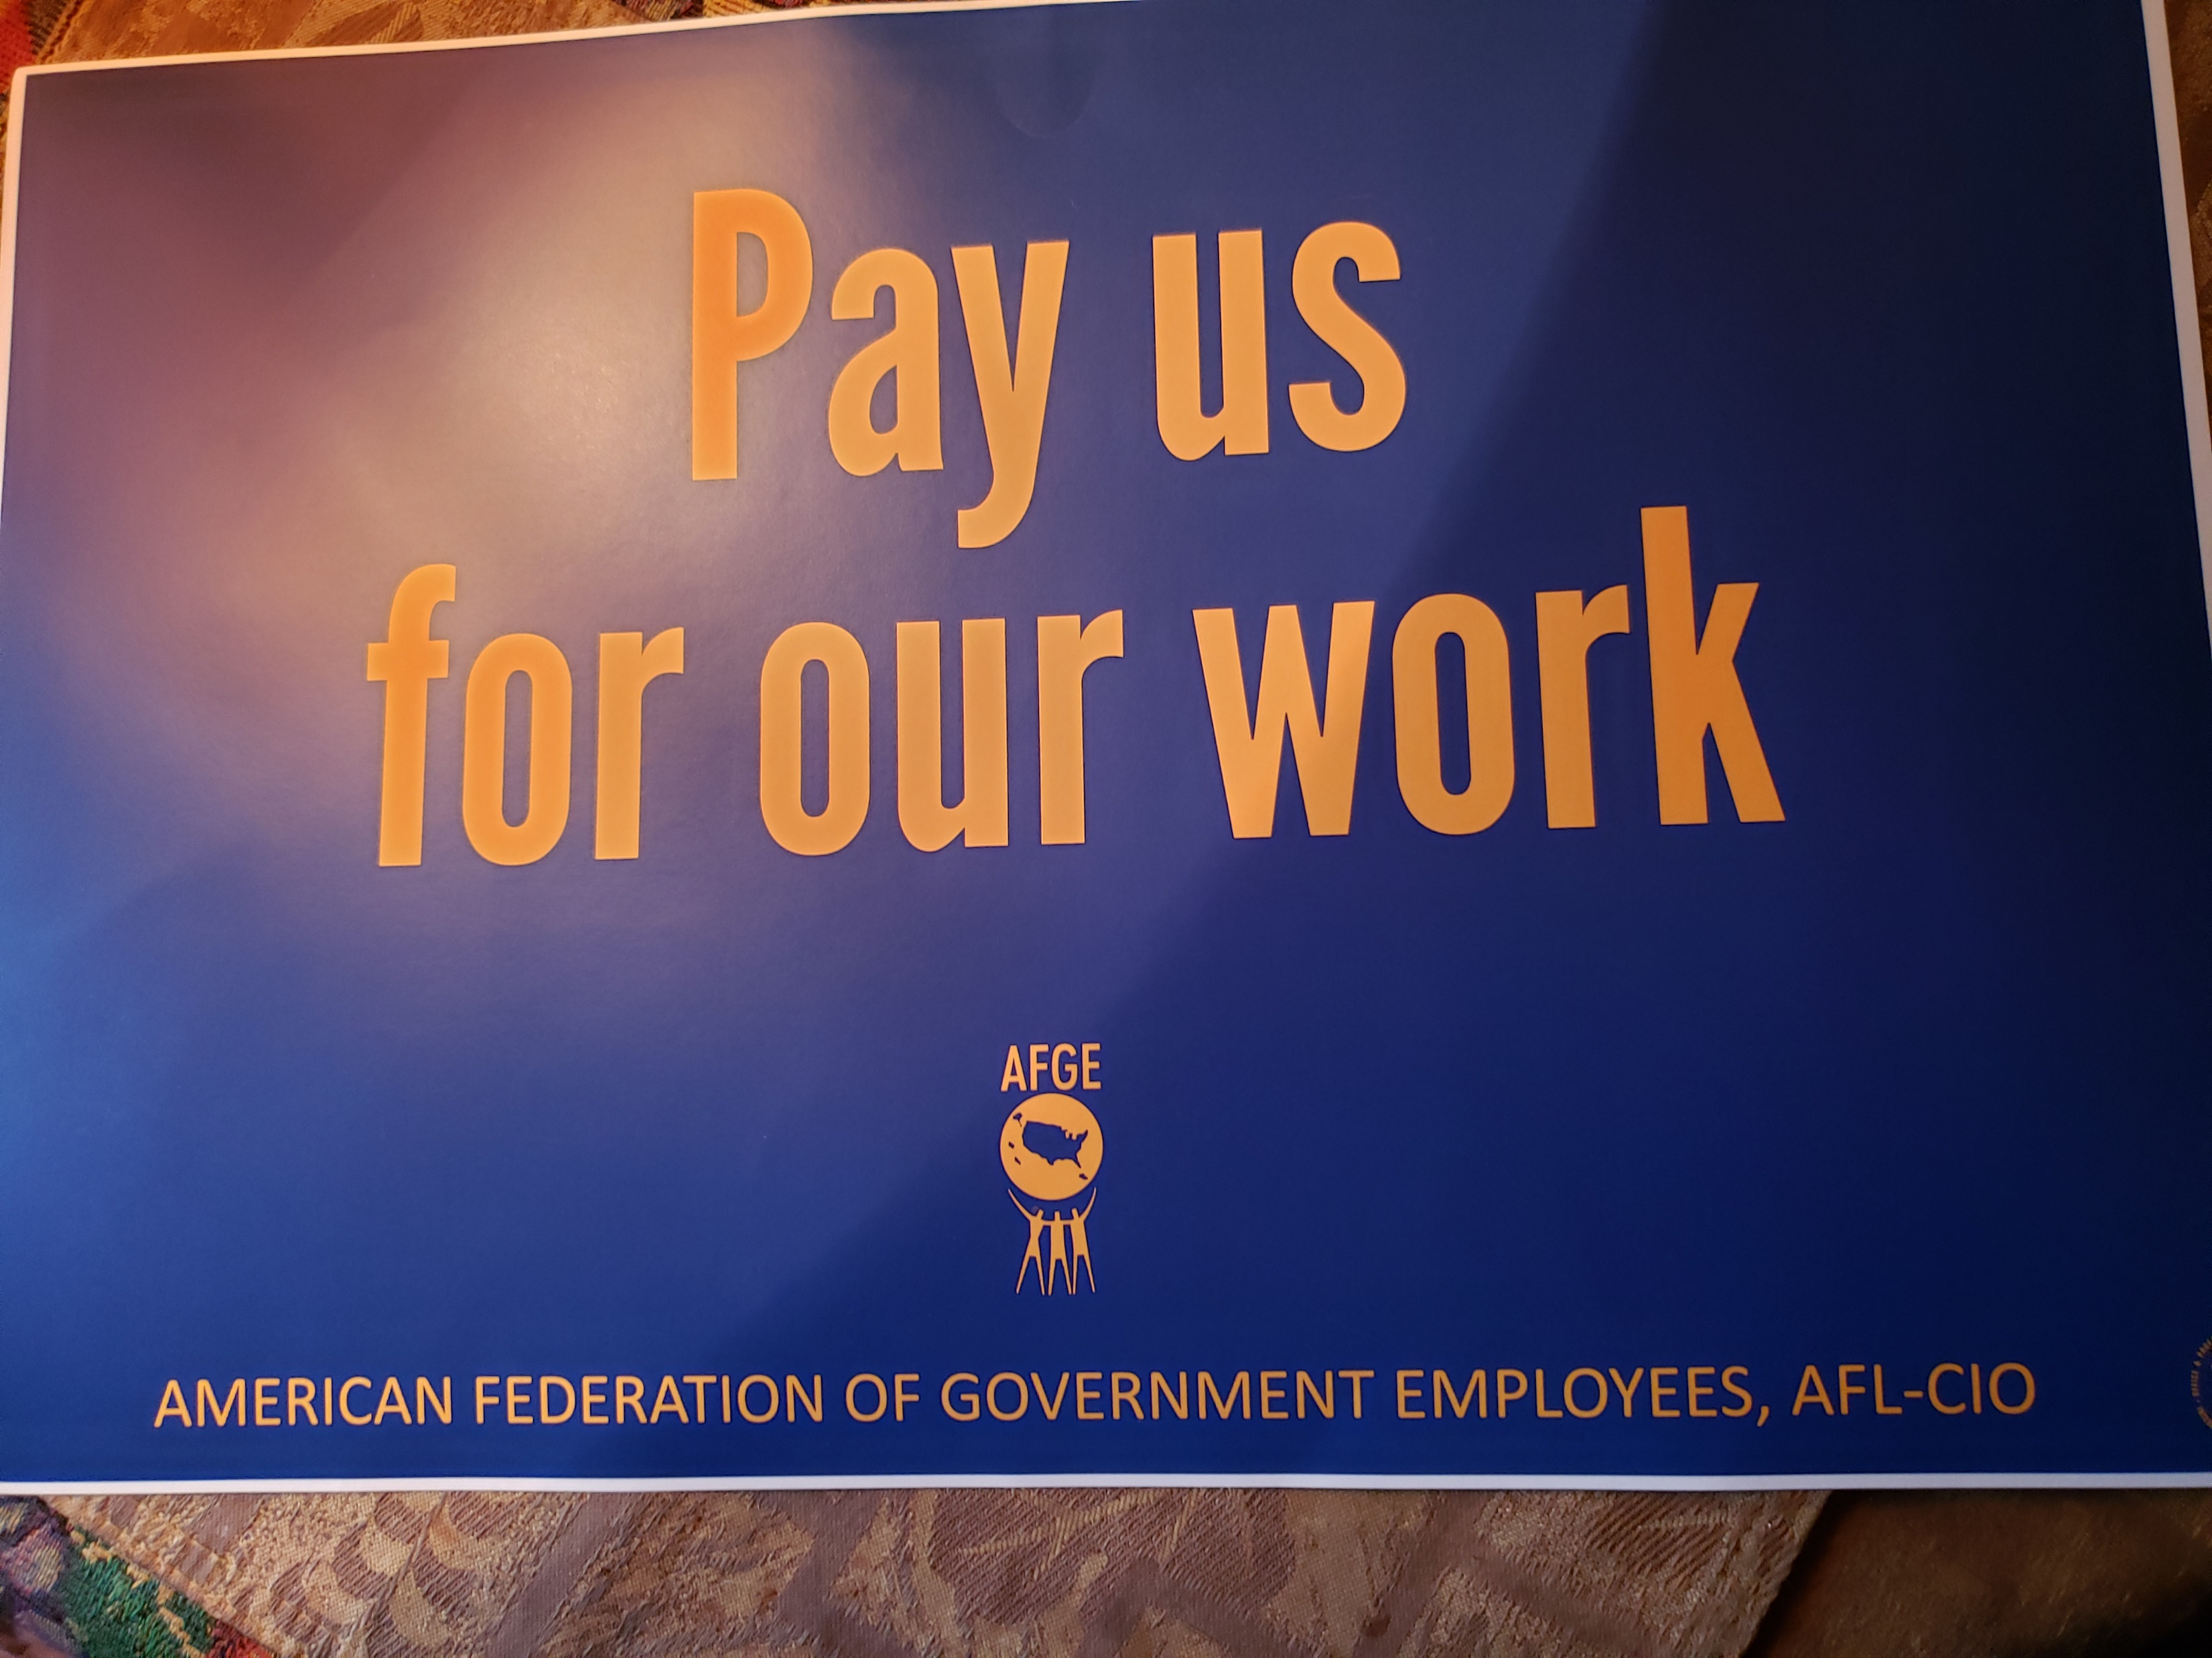

Slide 14
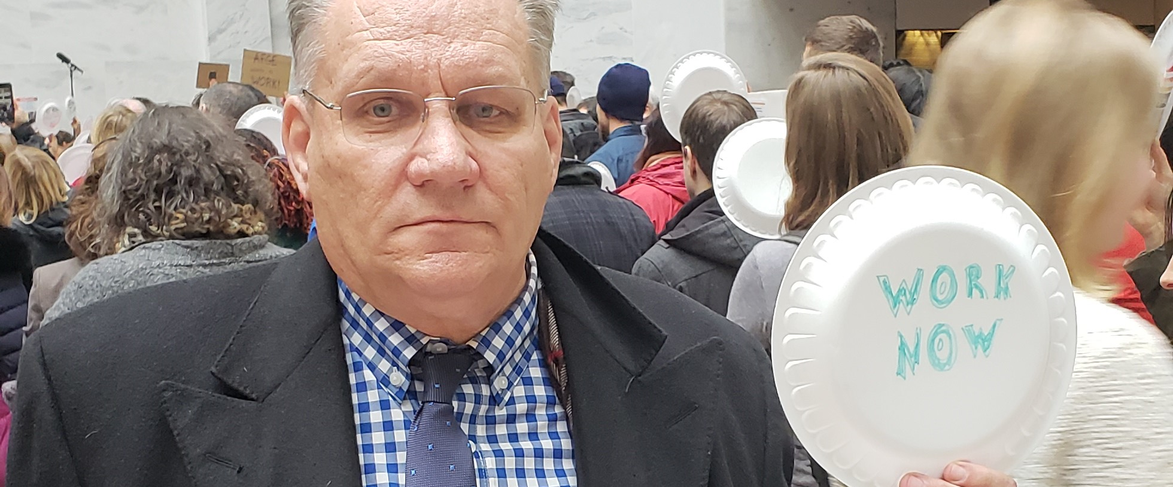
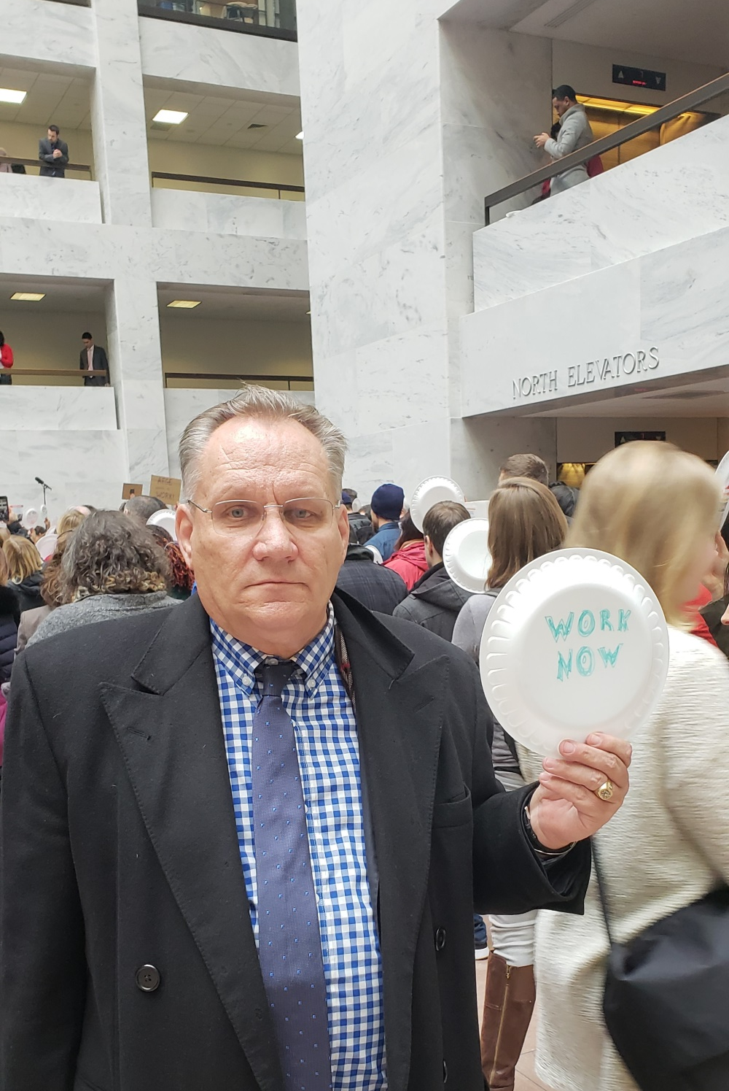
Senate silent protest

Slide 15
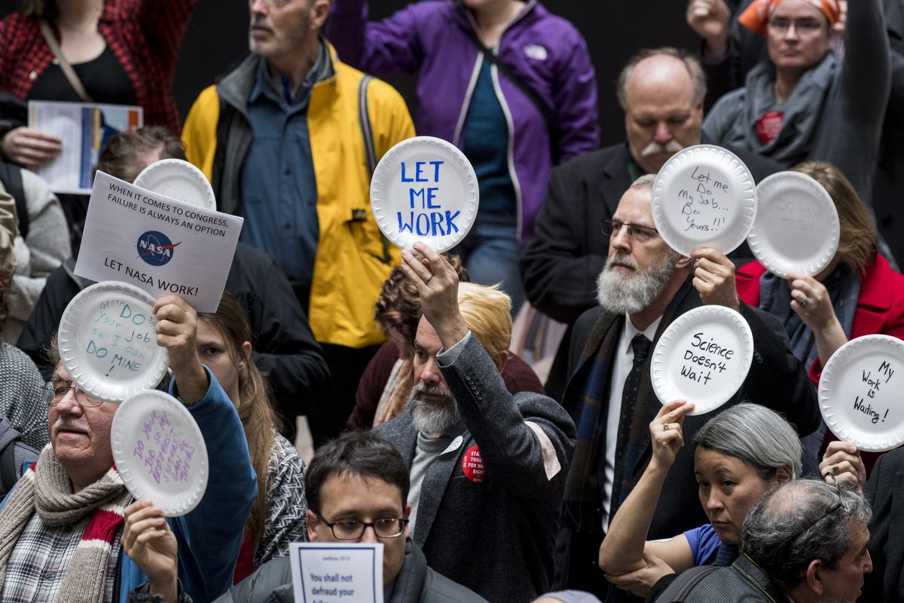
Silent Protest in Hart Senate office building, Jan ., 24, 2019

Slide 16
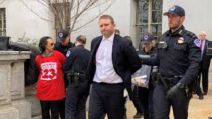
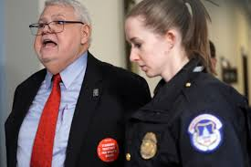
NFFE President Erwin Arrested Alongside Federal Labor Leaders and Furloughed Federal Employees Following ‘Occupy Hart’ Protest
Wednesday, January 23, 2019

Slide 17
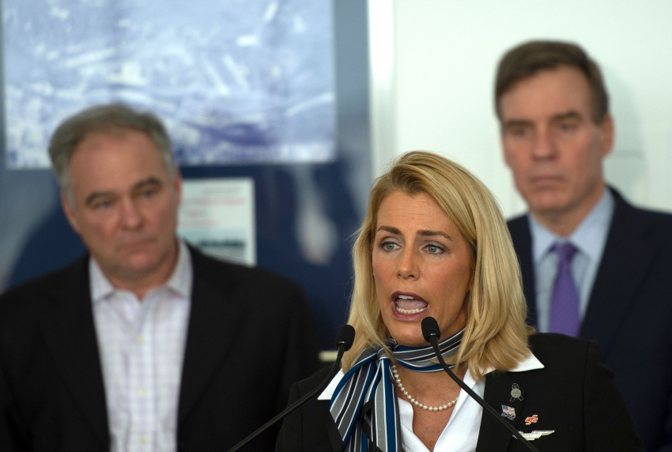
Sara Nelson – President, Association of Flight Attendants – Communication Workers of America (AFA-CWA)

Slide 18
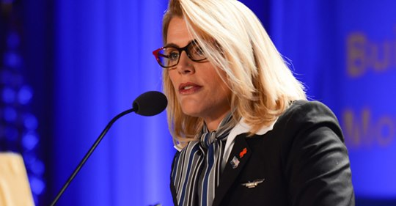
Sara Nelson is the face of New Labor
The New York Times, New Republic, The Nation, Slate, The Guardian, Salon, The Financial Times, CBS, CNN, and Popular Mechanics.

Slide 19
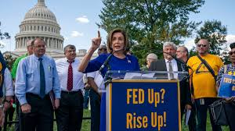
Fed Up – Rise Up Rally
September 24, 2019

Slide 20
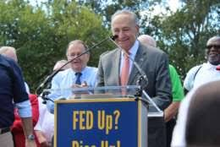
Union!
Union!
Union!

Slide 21
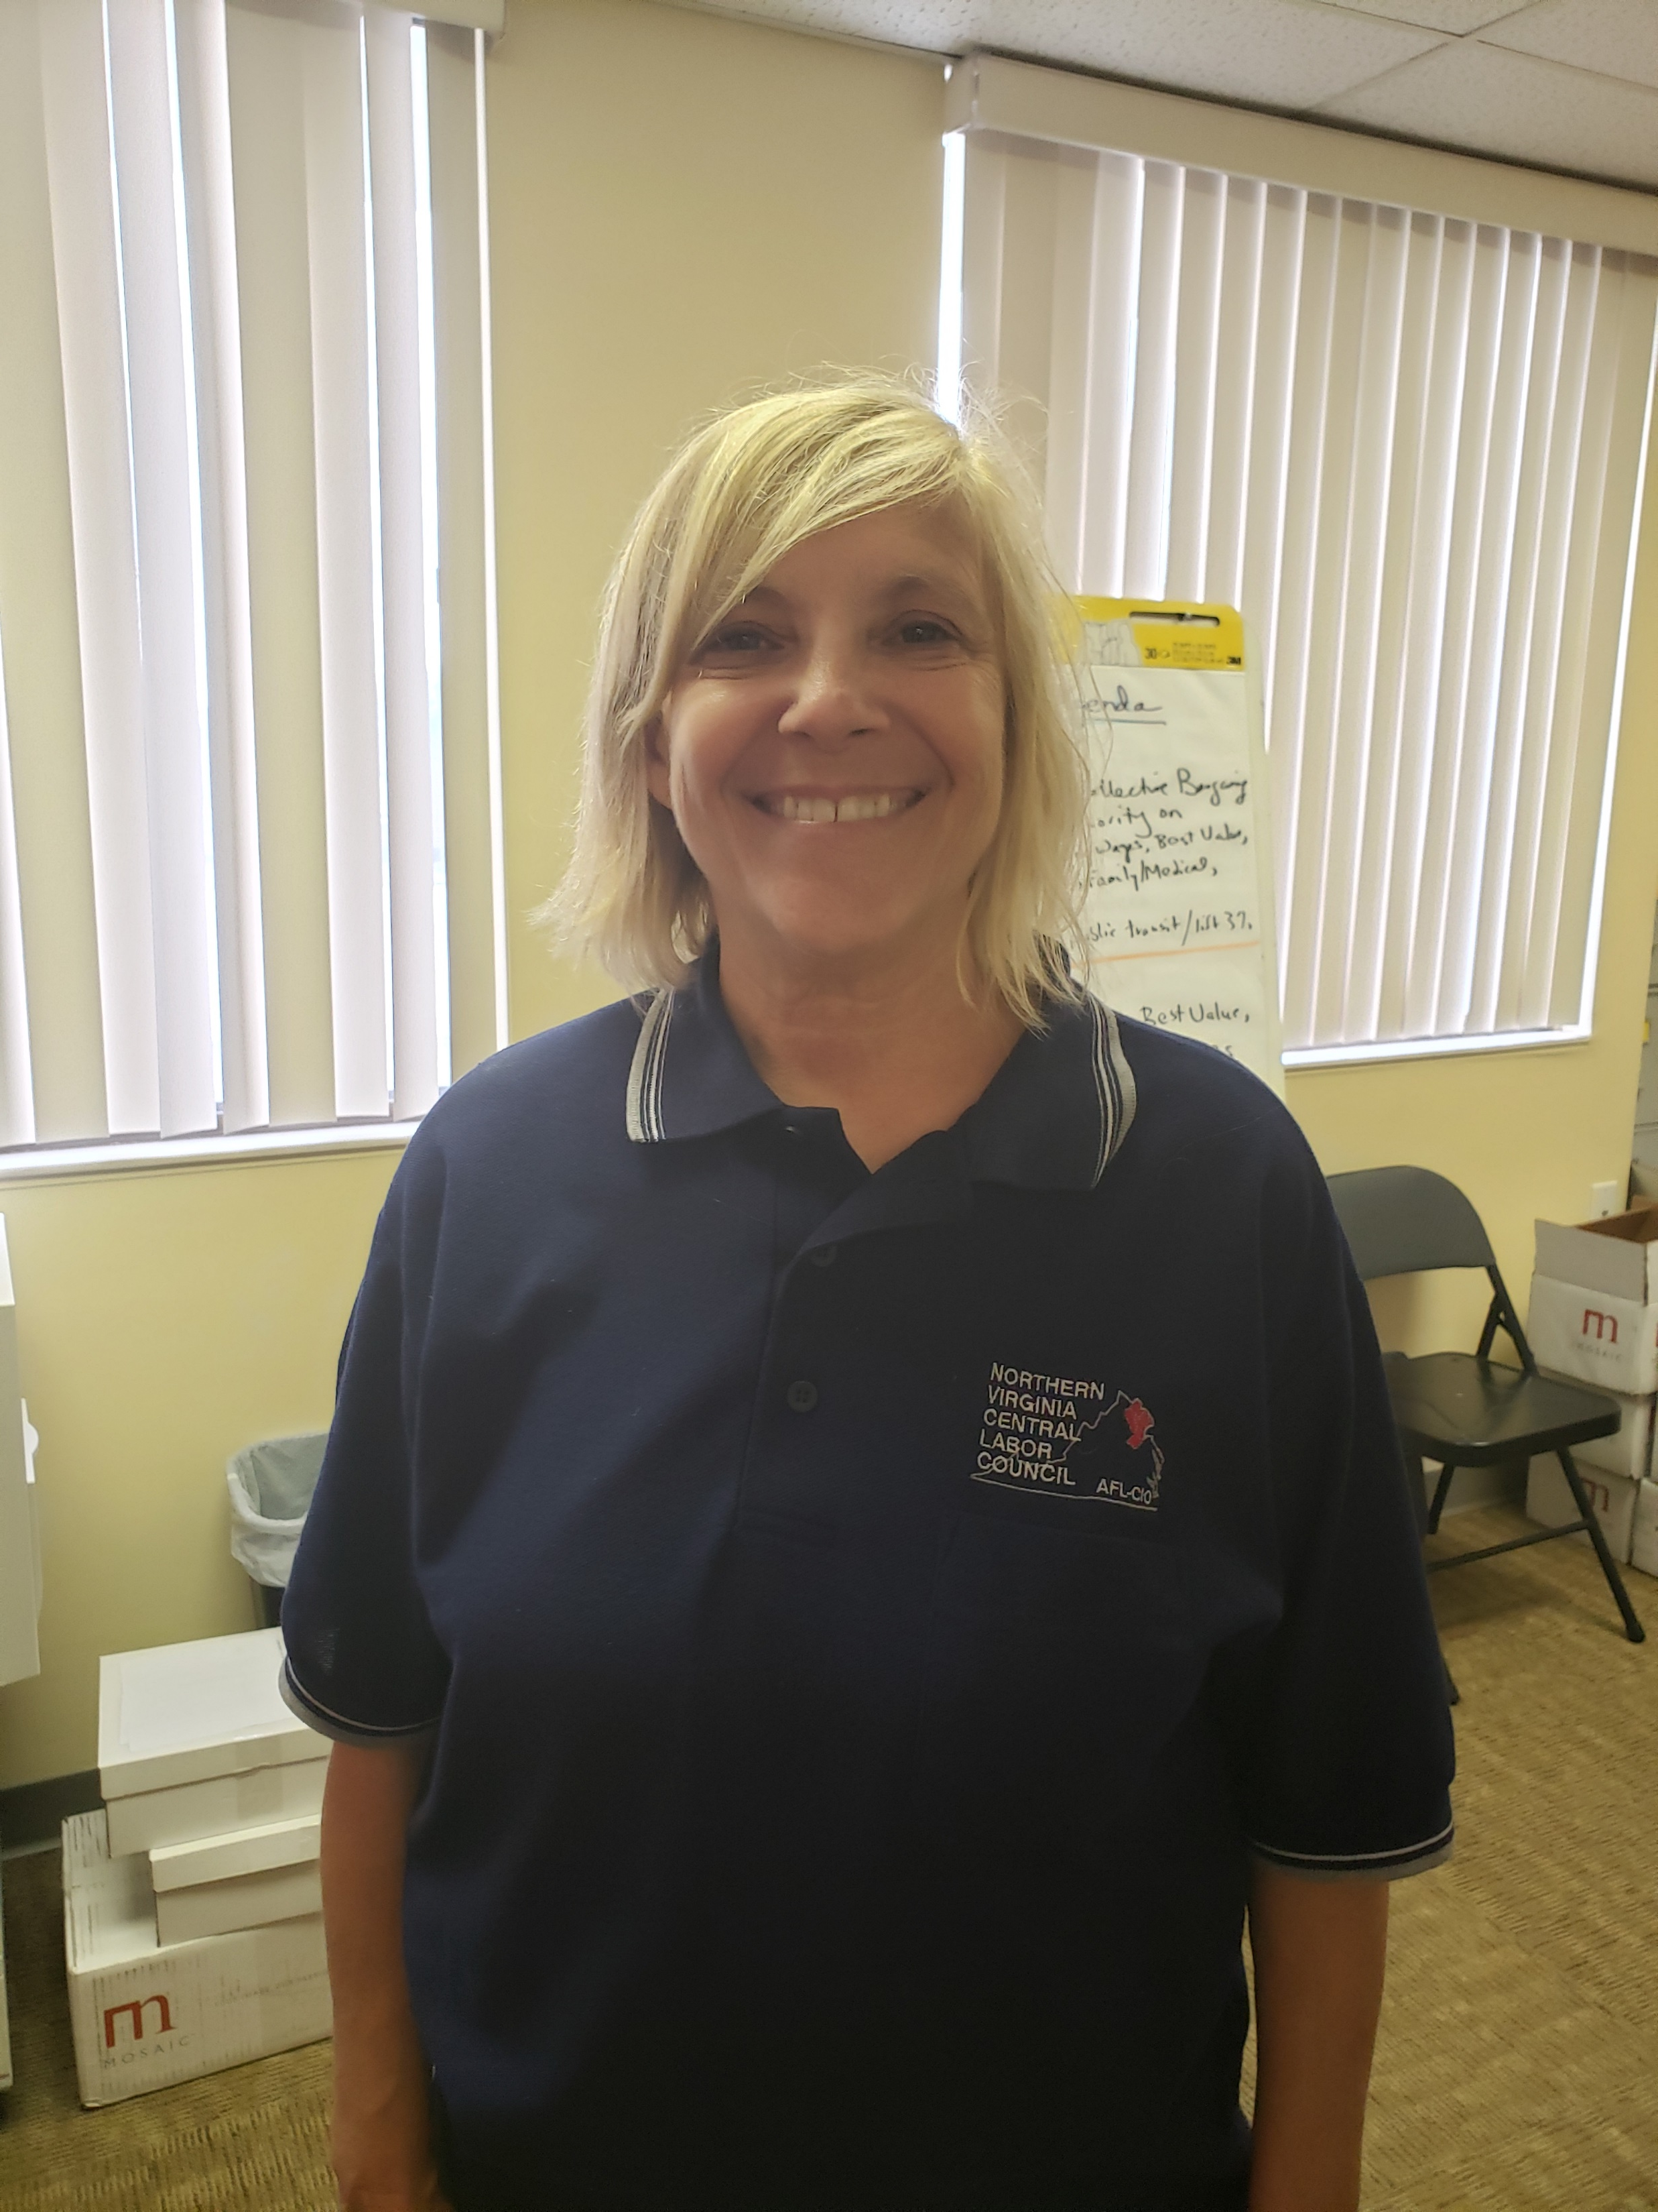

Slide 22
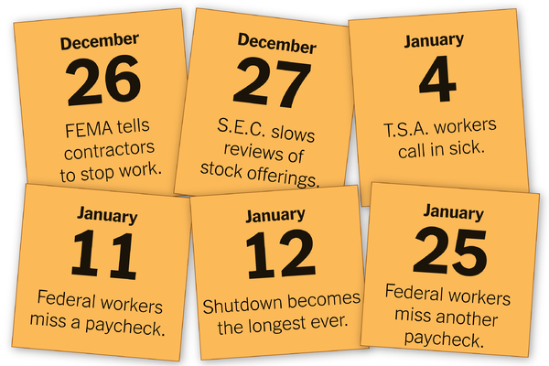

Key Dates: Shutdown 2018-19 (source :NY Times)

Slide 23
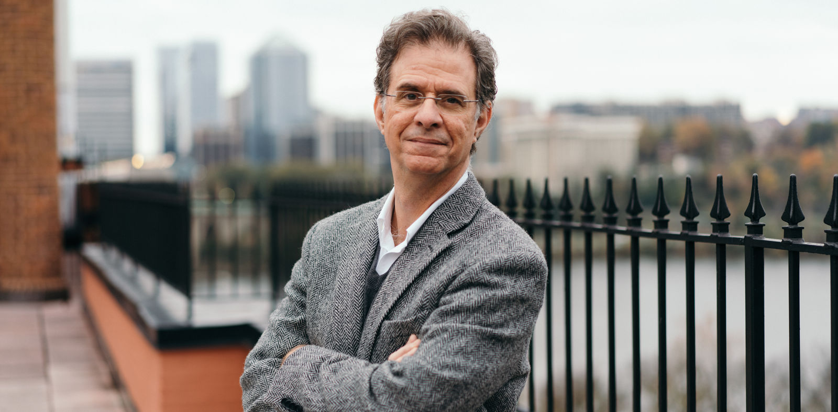
Joseph McCartin
Professor, History, and Director, Kalmanovitz Initiative for Labor and the Working Poor – Georgetown University

Slide 24
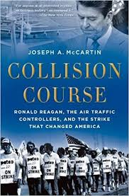
Collision Course by Joseph McCartin of Georgetown University

Slide 25
Vindication for PATCO
“Reagan fired their predecessors for striking in 1981. Today, they got sick, stayed home, and forced Trump to end the shutdown.”
The Air Traffic Controllers Even the Score. Harold Meyerson in the American Prospect, Jan. 25, 2019

Slide 26

Why teacher strikes are touching every part of America
Analysis by Zachary B. Wolf, CNN
Updated 8:32 AM ET, Sat February 23, 2019

Slide 27
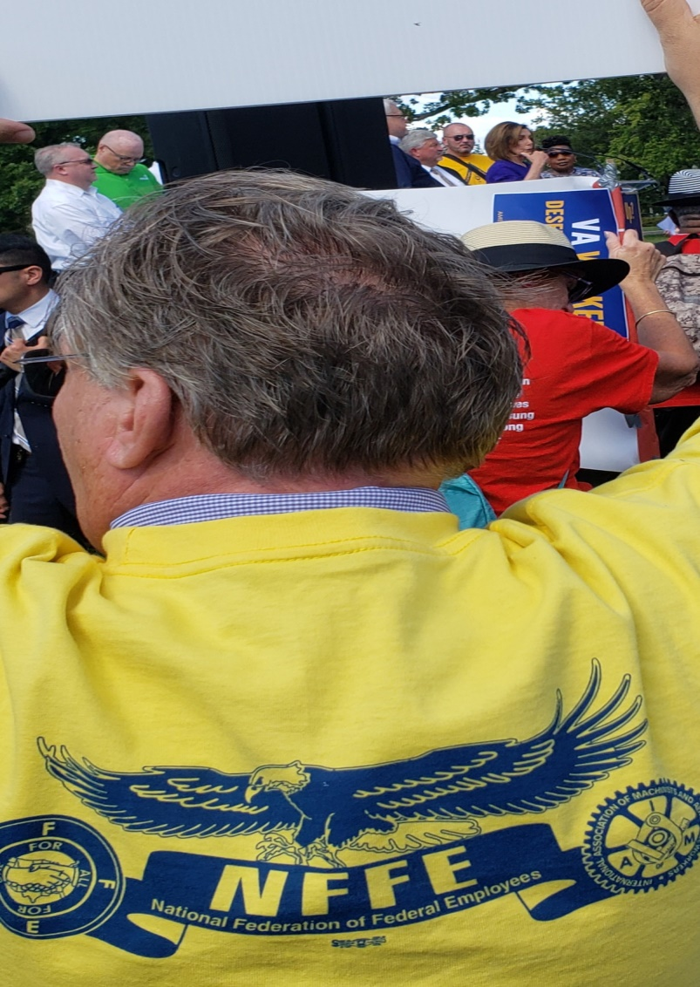
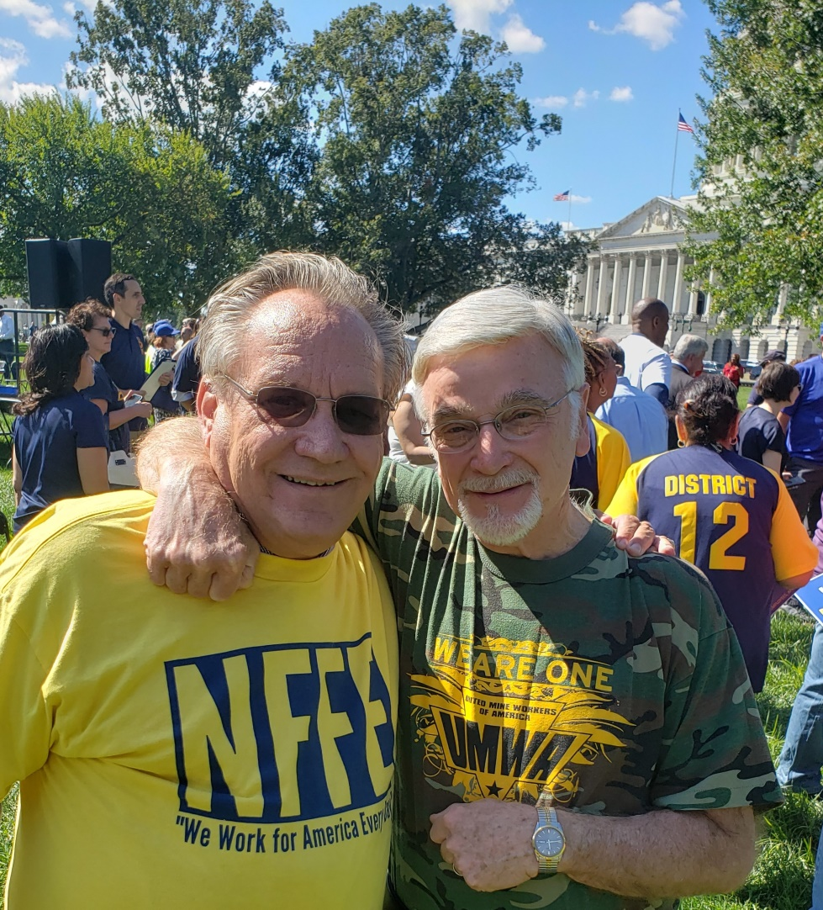
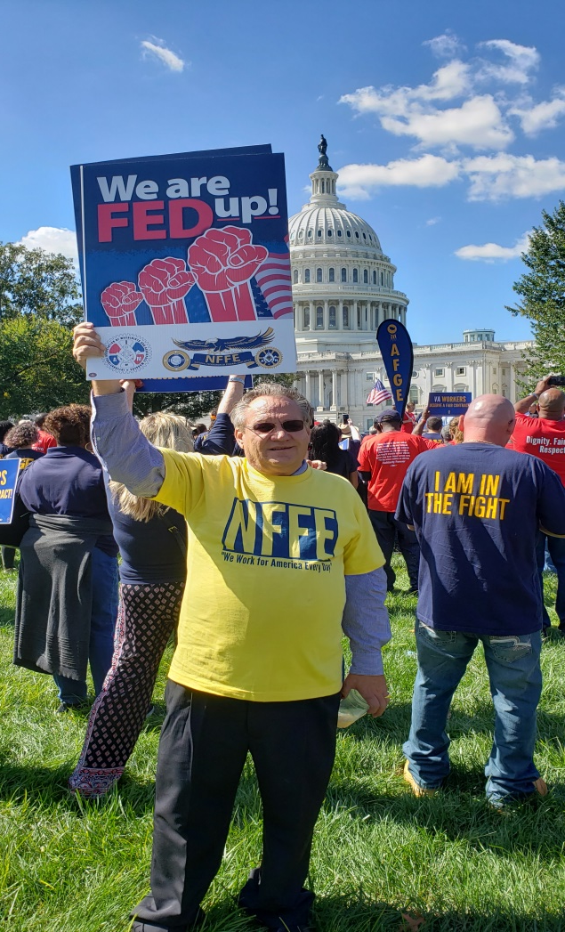
Fed Up Rise Up rally : Sept. 24, 2019 Capitol Hill

Slide 28
Fair Compensation for Low-Wage Federal Contractor Act-
The House bill would provide back pay to 580,000 federal service workers for the last shutdown.
Sponsored by Rep. Ayanna Pressley (D- Mass.)

Slide 29
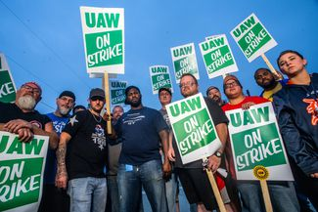
UAW strike against GM

Slide 30
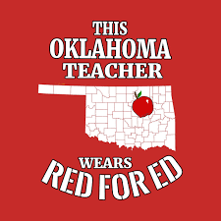


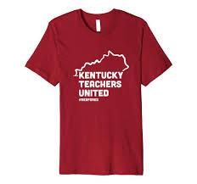


Teacher Strikes 2018

Slide 31
A larger worker movement is taking hold. Educators and government employees have rallied and marched on state capitals. Nurses, security guards, convenience store clerks and hotel employees have gone on strike to fight for fair working conditions. Members of the digital media, video game industry and the gig economy are organizing and unionizing to gain collective strength.

